Slide 1

Data Science Committee
Session 3 - Diamonds with SQL
Prepared by: Ashraf Abdulkhaliq

Slide 2
Outline
Tools
SQL Basics
Lab

Slide 3
Outline
Tools
SQL Basics
Lab

Slide 4

Tools
Jupyter Notebooks
JupyterLab is the latest web-based interactive development environment for notebooks, code, and data.
Its flexible interface allows users to configure and arrange workflows in data science, scientific computing, computational journalism, and machine learning.

Slide 5

Tools (cont)
SQLite
SQLite is a lightweight, self-contained, and serverless relational database management system (RDBMS).

Slide 6

Tools (cont)
Pandas
Pandas is a fast, powerful, flexible and easy to use open source data analysis and manipulation tool.
Built on top of the Python programming language.

Slide 7

Tools (cont)
Matplotlib
Comprehensive library for creating static, animated, and interactive visualizations in Python.
Matplotlib makes easy things easy and hard things possible.

Slide 8
Outline
Tools
SQL Basics
Lab

Slide 9
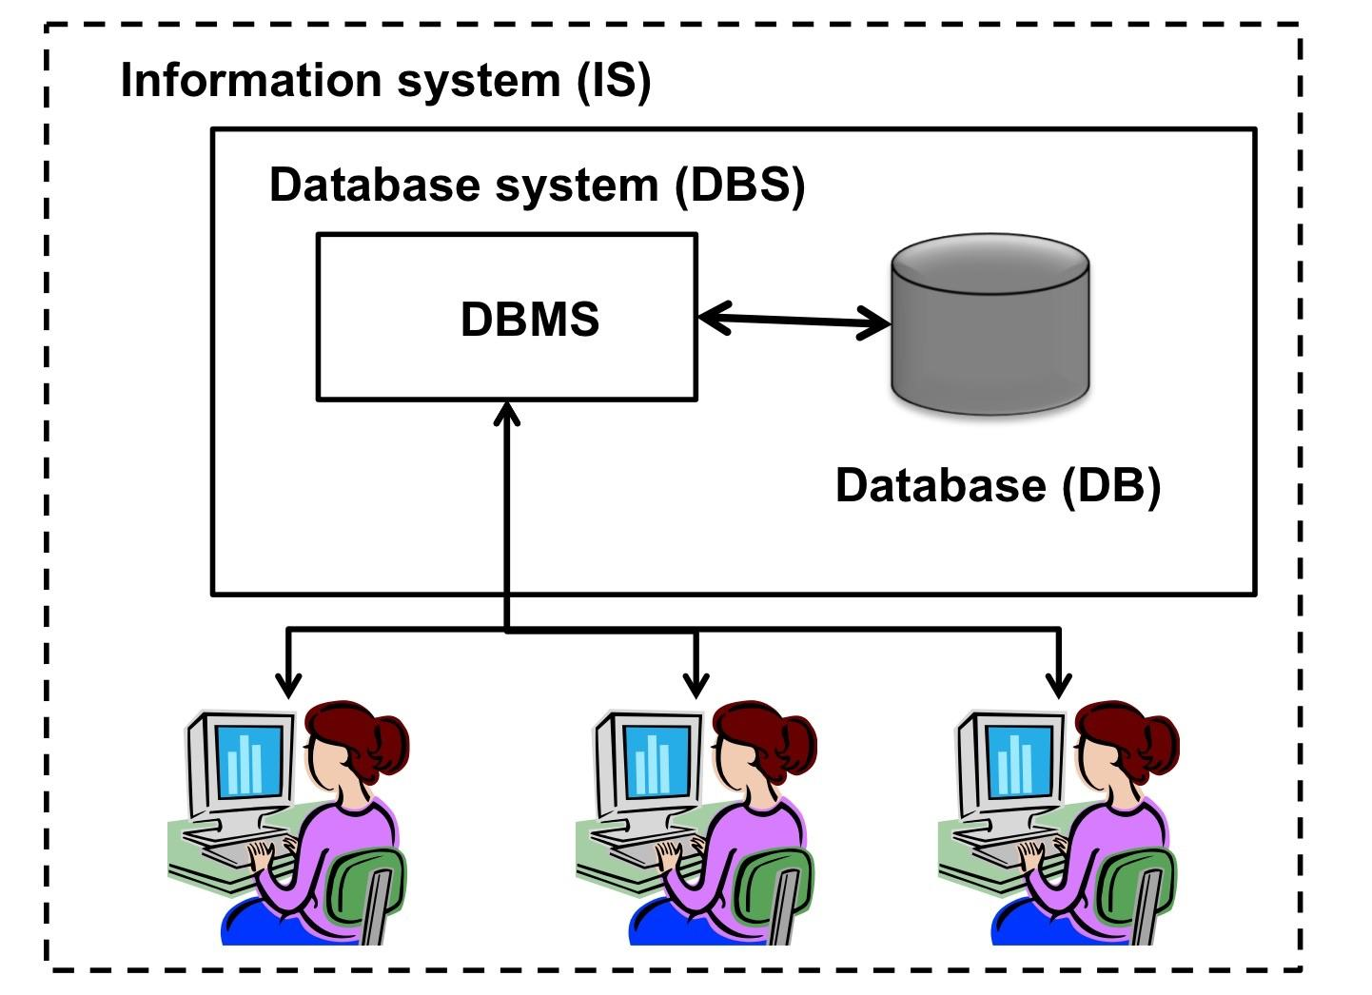
SQL Databases
Database (DB): where the data is stored physical/virtual.
Database System (DBS): A system for systematic and effective organization of data.
Database management system (DBMS): A Software to organize the data stored in the database.

Slide 10
SQL Databases (cont)
Structure Query Language (SQL): is a standard programming language used to operate Relational Databases and carry out various operations such:
Create new databases, tables, and views.
Insert records in a database.
Update records in a database.
Delete records from a database.
Retrieve data from a database.

Slide 11
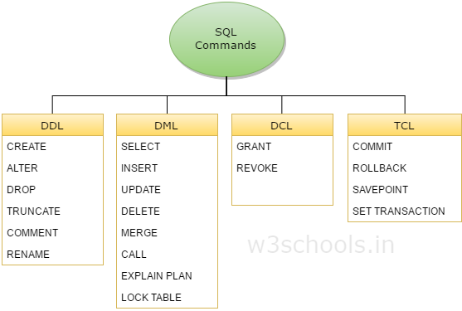
SQL Databases (cont)

Slide 12
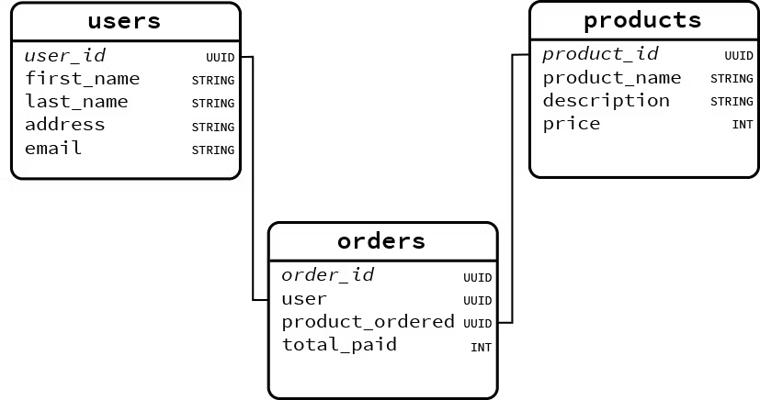
SQL Databases (cont)

Slide 13
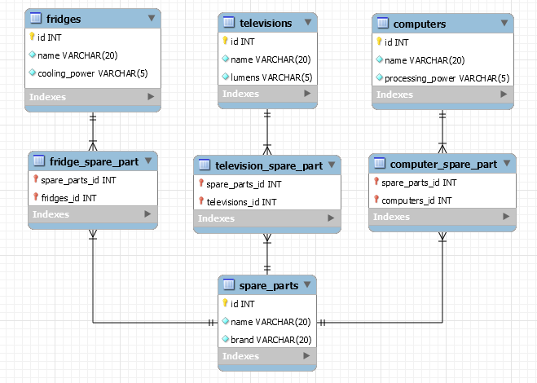
SQL Databases (cont)

Slide 14
SQL Statements
PRAGMA statement
PRAGMA table_info(table_name)
SELECT statement
SELECT column_name FROM table_name;
WHERE clause
WHERE conditions ..
JOIN cluase
JOIN Table2 ON Table1.Key1 = Table2.Key1
LIMIT clause
LIMIT number

Slide 15
Outline
Tools
SQL Basics
Lab

Slide 16
Lab
Open Juypter Notebook for session 03 to cover this topics in practice:
Data collection from SQL database using SQLite Python.
Basic data exploration using pandas.
Basic data visualization using matplotlib.

Slide 17
References
https://www.simplilearn.com/tutorials/sql-tutorial/what-is-sql
https://www.quora.com/What-is-the-difference-between-DBMS-DBS-and-DB

Slide 18
Thanks
Please keep updated:
https://github.com/kershrita/IEEE-Data-Science

